Slide 1
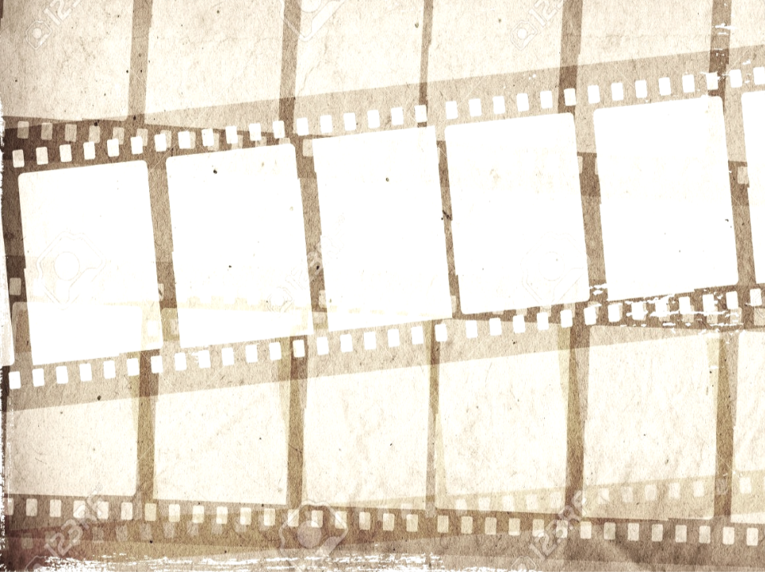
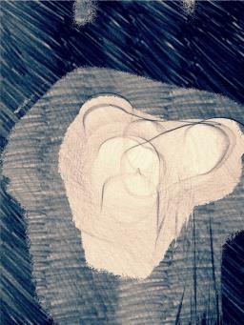
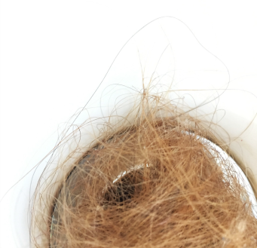
What?
Research and explore the theme ‘Senses’ and create a series of photographs inspired by this.
How?
Use any camera or phone to capture images. Produce a combination of photographs and digital edits in response to the theme, using a range of techniques and processes. Present your work in a Sketchbook or in a PowerPoint.
Why?
To develop and refine your observation and photography skills by looking more closely at things around you that you see and experience every day, and to experiment with editing techniques.
Y12 A level Photography
Transition Project
‘Senses’

Slide 2
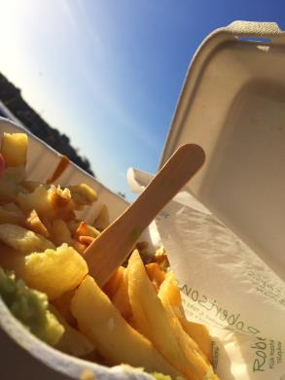
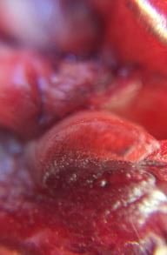
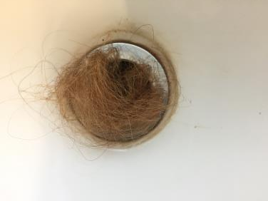
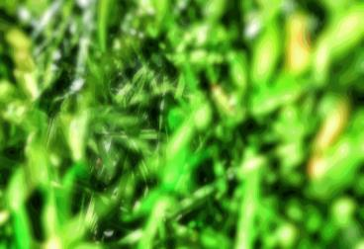
Senses
It is the aim of many photographers to show not just what a place, person or object looked like, but also what it felt like to be there. It can be a challenge to convey the senses of seeing, listening, tasting, smelling, and touching through a photo, but by taking some time and thought as to how you can heighten the viewer’s senses, you can transport someone to a different place and time through your images. By using and focussing on your five senses, you will also begin to notice important details which are often overlooked, from the sound of a repetitive dripping tap, to the smell of the air outside when it has just rained.
Touch Sight Hearing
Smell Taste

Slide 3
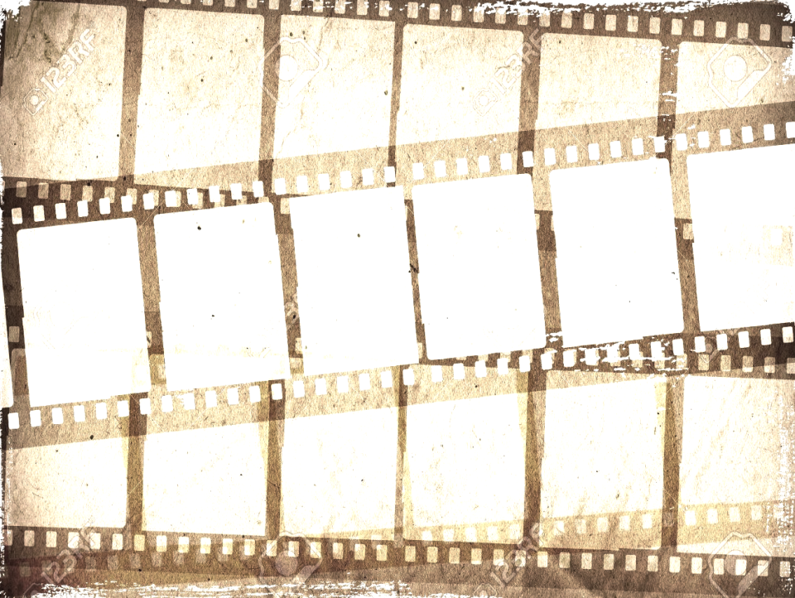
Task 1
Create a mind map in a sketchbook or on a PowerPoint, exploring the 5 senses in relation to photography. Think about the ways that photographs can remind us of experiences and feelings and how we perceive this using our senses. How can smells, tastes and sounds be captured in a photograph?
Task 2
Research, analyse and compare the work of 2 of the photographers on the slides below and create at least one page for each (or choose your own). Look closely at how their work relates to the senses and discuss this in your analysis. Use the writing frame to help you structure your analysis.
Task 3
Take 6 photographs for each of the headings on ‘The Senses’ slide. The first one should be a literal representation of the description, and the second should be a more abstract version without any recognisable features or objects.
Task 4
Create your own series of photographs exploring each of the 5 senses. You can use whatever editing techniques and processes you feel most appropriate, and you should also think about how you could present your images to enhance the sensory experience of the viewer. Each sequence/sense should consist of 6 finished images, and you should include your contact sheets and editing process to your sketchbook or PowerPoint. As usual, include full annotations.

Slide 4
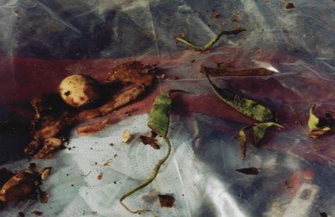
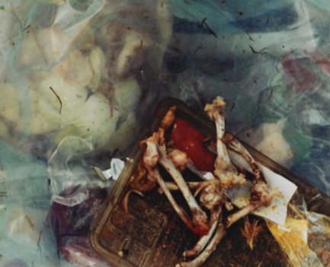
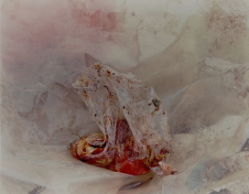
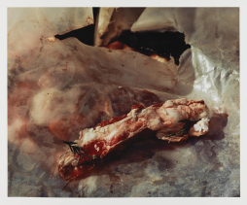
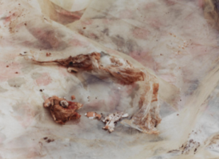
Keith Arnatt
Pictures from a Rubbish Tip
Keith Arnatt created this series of large colour photographs featuring close-up shots of rubbish which was dumped at a tip. The photographs show discarded food items on plastic bags and were taken in daylight with a shallow depth of field. At first glance, some of the food is hard to recognise, but when looked at closely, the mouldy, dirty food appears clear.

Slide 5
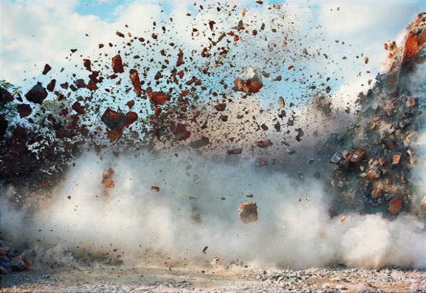
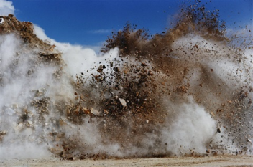
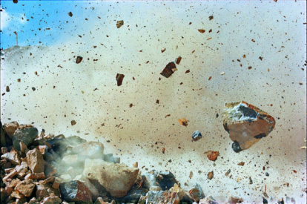
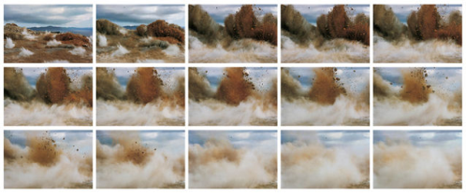
Naoya Hatakeyama
Blast
These pictures are part of a series called “Blast” taken by Japanese photographer Naoya Hatakeyama, who used remote-control cameras to capture the drama and destruction of Japan's limestone blasting operations from point blank range.

Slide 6
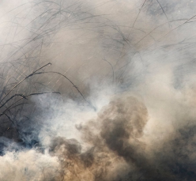
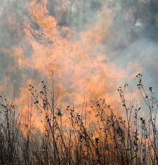
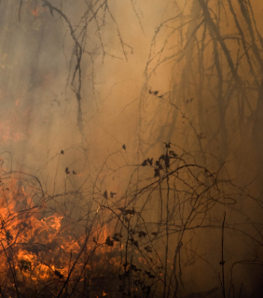
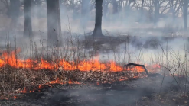
Jane Fulton Alt
‘The Burn’
This sequence of photographs and video by Jane Fulton Alt are of controlled forest fires. She photographed the burning fires for 3 to 4 hours each day, trying to capture and convey a sense of the oppressive and suffocating heat, along with the smell and taste of the fires as they burned.
https://vimeo.com/74571336

Slide 7
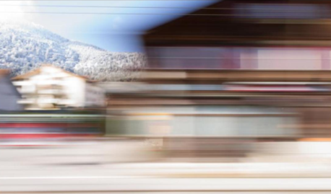
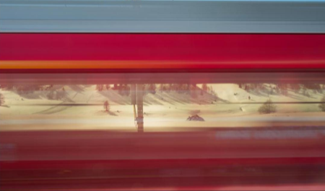
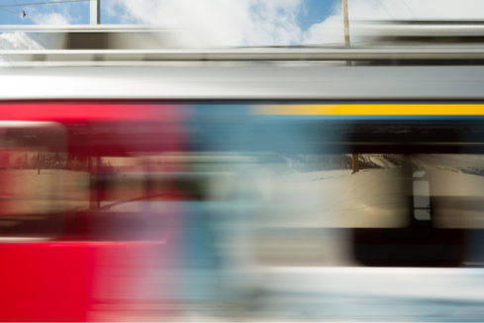
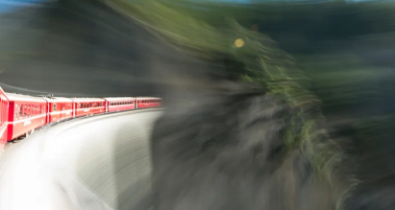
Rolf Sachs
‘Camera in Motion’
Rolf Sachs blurs the boundaries between abstract art and landscape photography in this series of images, Camera in Motion. The images, photographed from the windows of a moving train, bring to our minds memories of family road trips experienced from the back seat of the car with your forehead pressed against the car window, watching the landscape streak by at 70 miles per hour.

Slide 8
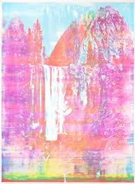
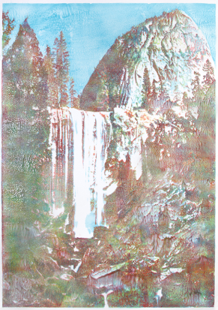
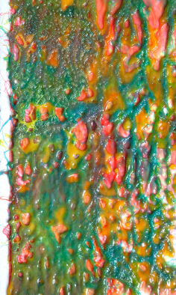
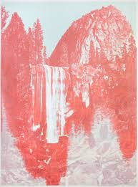
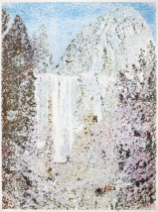
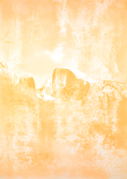
Matthew Brandt
‘Taste Tests’
In Matthew Brandt’s Taste Tests photographs, he uses unusual food and drink items to create his images. This includes Kool Aid, ketchup, mustard and Cheez Wizz which he uses to make ink which is then used to create screen printed photographs of American landscapes.
https://matthewbrandt.com/tastetests

Slide 9
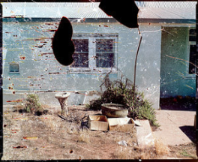
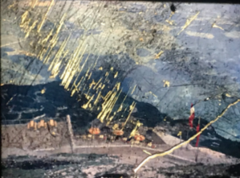
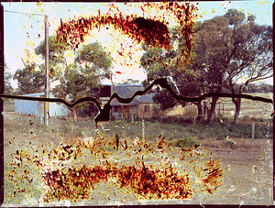
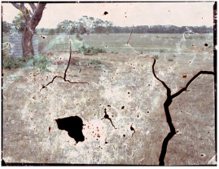
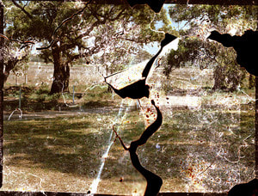
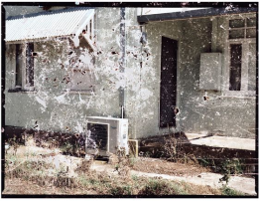
Odette England
‘Thrice Upon a Time’
Odette England returned to her childhood home with her parents and gave them old photographic negatives she had previously taken of places on the farm where her parents had photographed her as a child. She fastened them to the soles of her parents’ shoes and they walked through the farm and land.The negatives which were damaged and torn, were then pieced back together and re-printed to show all of the marks and scratches from the rough ground on the farm.

Slide 10
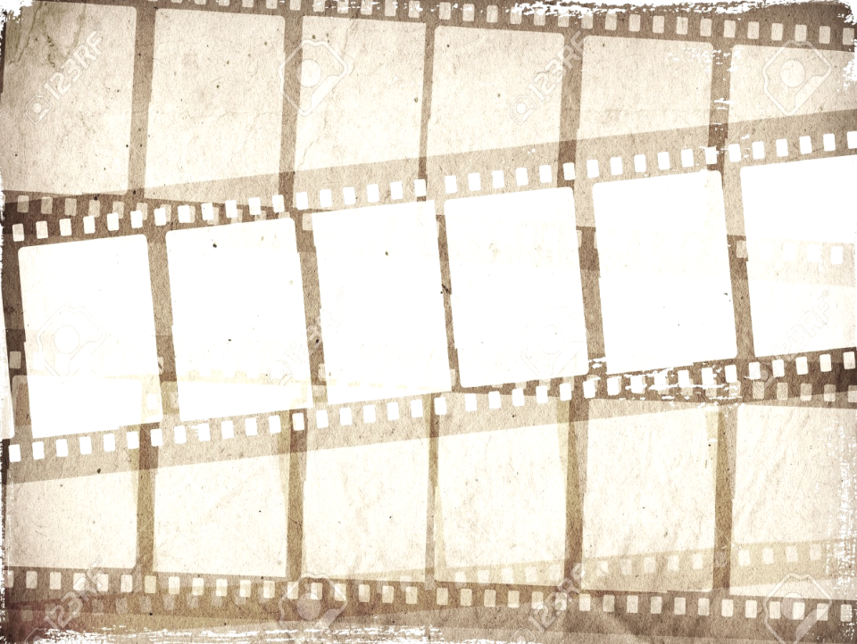
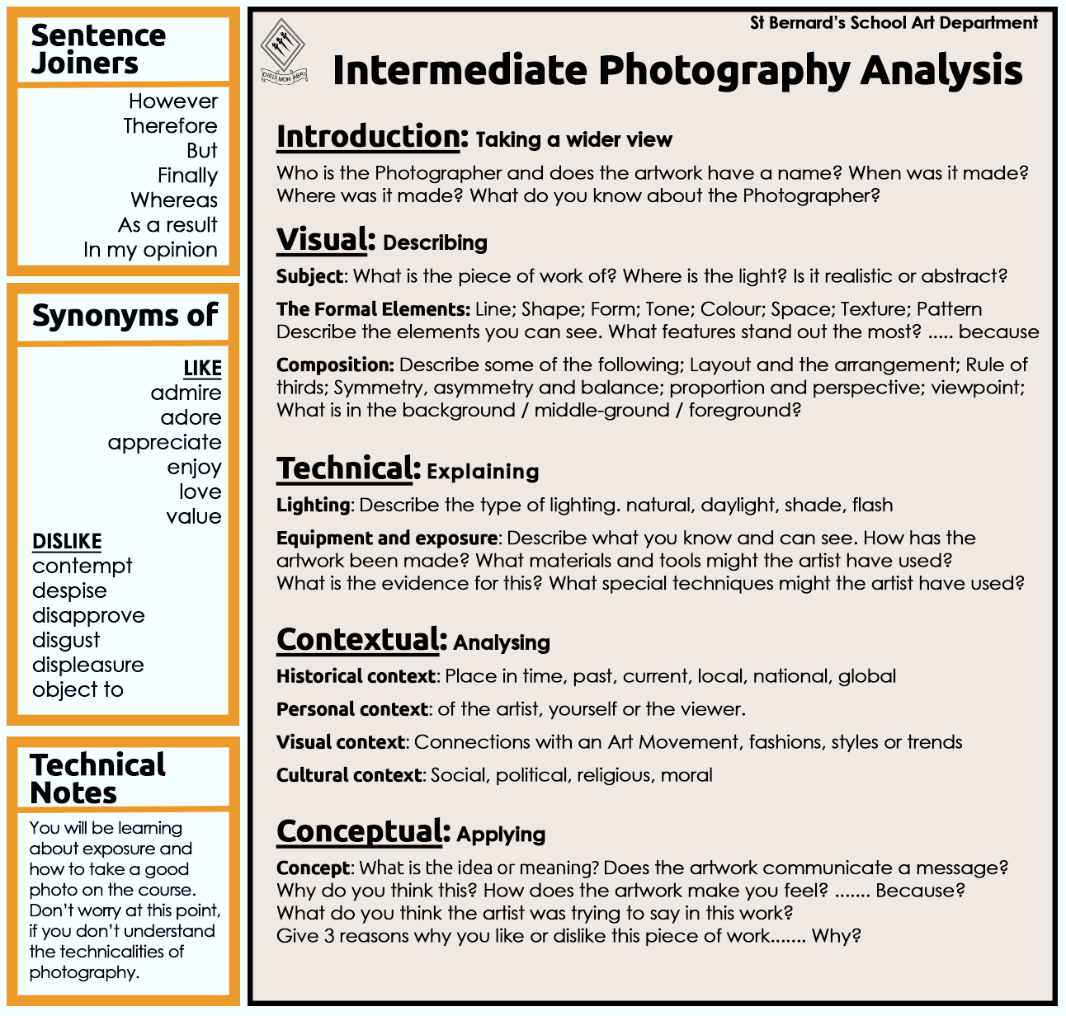

Slide 11
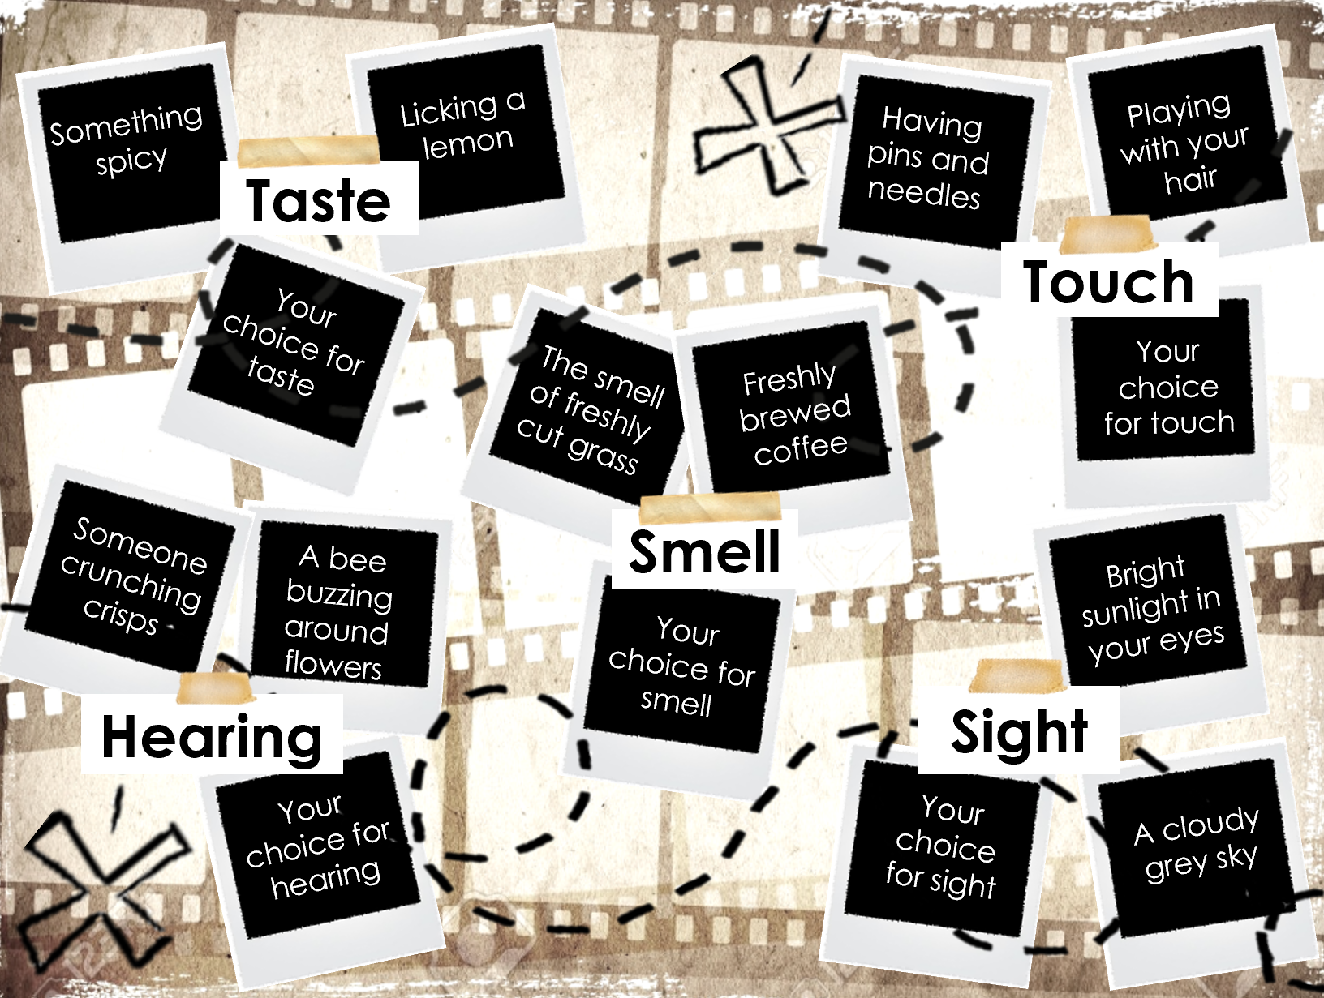
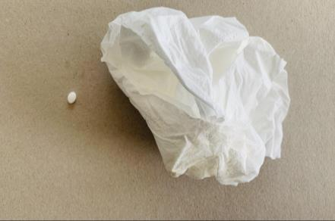
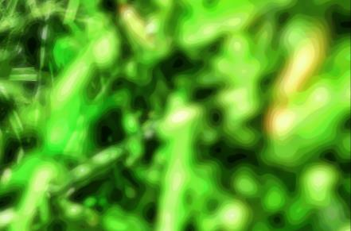
Task 3
Take 6 photographs for each of the sub-themes on the next slide. A total of 30 images.
The first photo should be a literal representation of the description, such as a lawn mower for the smell of freshly cut grass.
The second should be a more abstract version without any recognisable features or objects. It could include the colours, shapes and textures that you associate with the smell.
Photo 1: Cut grass by Mrs Every. She has hayfever and whilst she loves the smell of cut grass, it makes her sneeze, therefore she has chosen to photograph a tissue and hayfever tablet.
Photo 2: Cut Grass. In this image, Mrs Every has chosen to imagine being really close up in amongst the blades of grass, and has made parts of the image out of focus to convey how dizzy the smell of the grass makes her feel.

Slide 12
Something spicy
Licking a lemon
Having pins and needles
Playing with your hair
Licking a lemon
Taste
Touch
Your choice for taste
Your choice for touch
The smell of freshly cut grass
Freshly brewed coffee
Someone crunching crisps
Smell
A bee buzzing around flowers
Bright sunlight in your eyes
Your choice for smell
Hearing
Sight
Your choice for
hearing
Your choice for sight
A cloudy grey sky

Slide 13
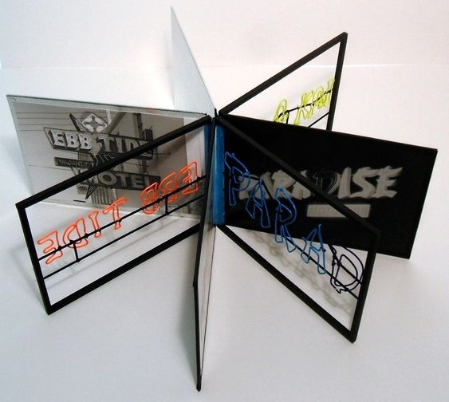
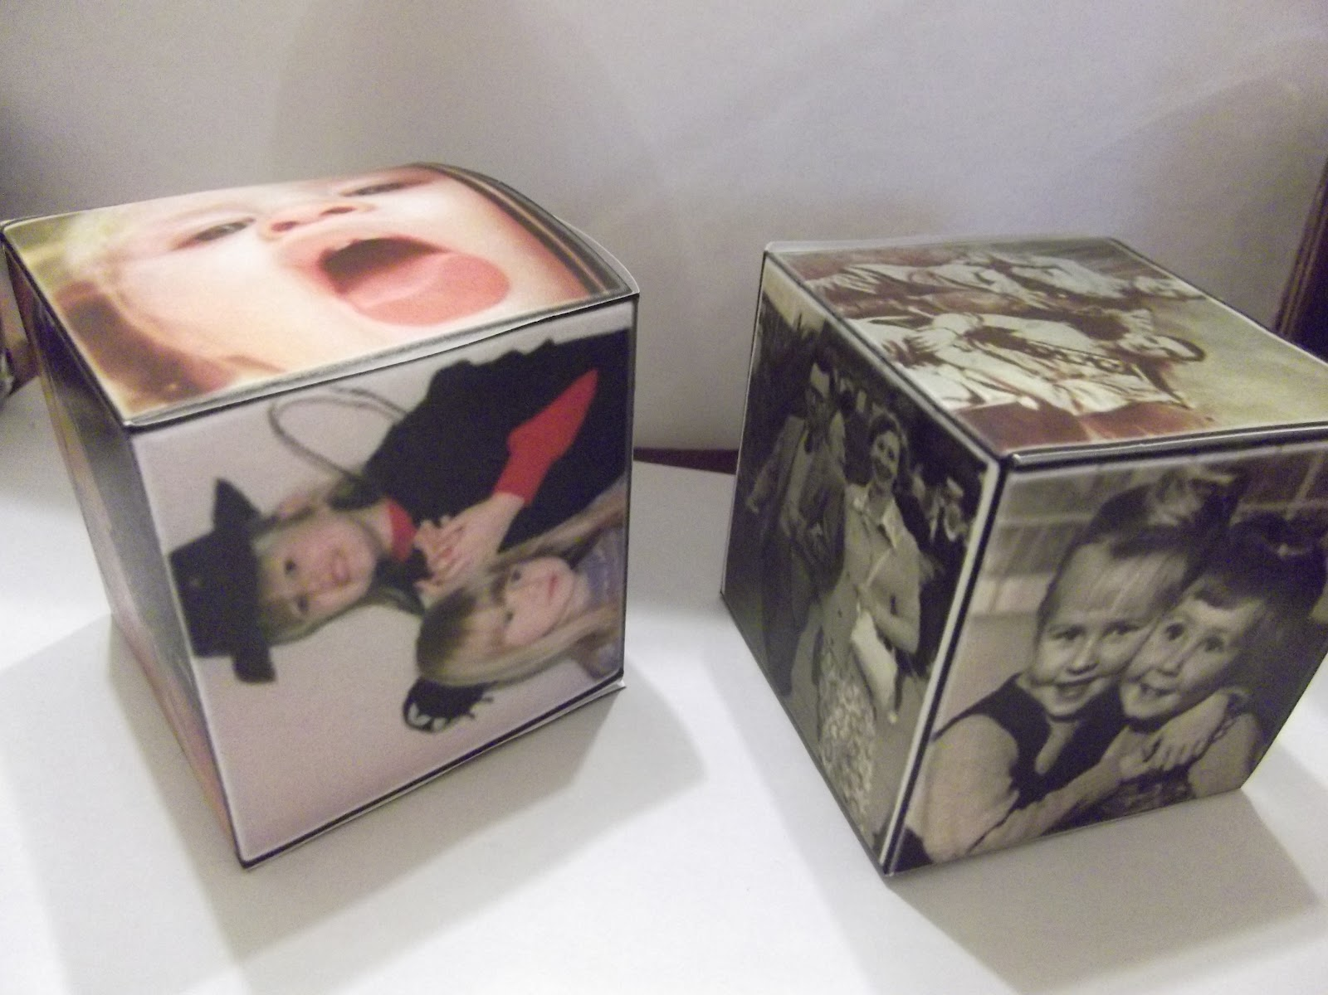
Task 4
Create your own personal series of photographs exploring each of the 5 senses.
You can use whatever editing techniques and processes you feel most appropriate.
Photoshop is available on the VLE. You can edit images in Word. Or download free Apps on to your phone such as, Adobe Photoshop, Photopea and Snapseed.
You could also think about how you might present your images to enhance the sensory experience of the viewer.
Will you stick to presenting your images in a traditional format, create 3D presentation or make a short film or time-lapse video that is relevant to the sense.
Each sense should consist of a series of 6 finished images.
Use your photographers research and the slides below about each sense for ideas and inspiration.
Add contact sheets to your slides and annotate them.
When editing your images, make sure that you have taken screenshots of different stages to show the process and have annotated this.

Slide 14
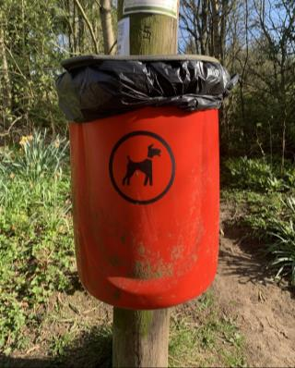
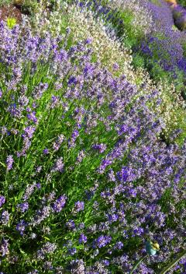
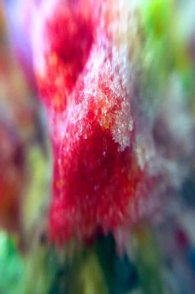
Smell
A single smell can take you back in time and suddenly you remember a childhood memory such as your favourite school dinner(Chicken Burger Wednesday for CLV Students) or even the smell of the changing rooms at school! Think about ways to capture a specific smell in your photographs, or a suggestion of the smell from a particular food, environment or person. How could your photographs suggest or evoke memories of a time and a place through the sense of smell?
Think about:
What triggers the sense of smell you are trying to convey?
When you think of the smell, what images immediately come to mind?
Is this smell and memory personal to you, or would others also experience it when looking at your photos?
Could you use objects as prompts and shoot them close up or using a macro setting to create a more abstract image?

Slide 15
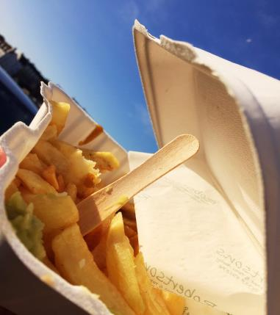
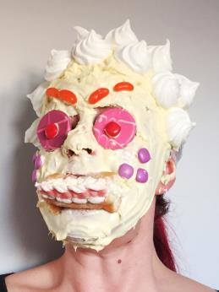
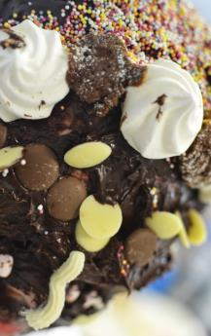
Taste
We rely so much on our eyes to gain a first impression of what would taste good; there is the saying that you eat with your eyes, meaning that visuals are an important factor in taste. When we taste something, we often associate it with the colour, the texture, the smell and the temperature which creates a whole experience. Think about eating your favourite food or drink and the emotions associated with this, are the sensations warm, sweet, crunchy, cold?
Think about:
How can you describe and convey the way something tastes visually in an image?
How could you make the viewer feel as if they could actually taste the subject matter?
Could you show different taste sensations such as sweet, sour, bitter and savoury in your images?

Slide 16
Sight
Photography is a medium which is largely based on the sense of sight, both when creating an image and looking at it afterwards. How can you create a photograph that conveys a sense of sight or a memory of something that you have once seen? Also, how do you go beyond the obvious when creating a photograph that conveys a sense of sight? For example, could you shoot a photo from the perspective of a child to show how you as a child saw a scene?
Think about:
When you think of a visual memory or sight, what images immediately come to mind?
Is your image in colour or black and white? Why?
Is this view personal to you, or would others also experience it when looking at your photos?
Could you use a macro setting to create a more abstract image?

Slide 17
Hearing
How could you photograph the sounds and things that you hear in a photograph? Although photographs are visual and often based on how they look rather than how they sound, it is possible to incorporate an element of sound into a photograph. Video is an option here, but a sense of sound can also be achieved with a still image. In a photograph of a group of children playing, you can often ‘hear’ them chattering away, and in a photograph of trees blowing in the wind, you can often ‘hear’ the sound of the leaves rustling as they move, or fireworks as they crackle in the sky.
Think about:
What kind of sounds can you hear when you look at a still image?
Could you use a frozen moment in time, to suggest implied sound, for example a person walking across a room with a foot in the air mid-motion with a sense of movement, means that that the viewer imagines they can hear the moment the foot is placed on the ground.

Slide 18
Touch
In many photographs, you can often imagine the feeling of being able to reach out and actually touch the object or person in the photograph. Some photographers achieve this by focussing closely on details which show surface texture which increases our sense of touch. Think about what it feels like to hold someone’s hand, stroke your pet or have a cold winter wind blow in your face. How could you capture and convey these experiences in your photographs?
Think about:
How do you feel when you touch different surfaces and what shapes and colours immediately come to mind?
How could you make the viewer feel as if they could actually touch the subject matter?
Could you use a macro setting to focus on the close up details and textured of the surface?

Slide 19
Links to read and use for inspiration
What Does a Photograph Sound Like?
Seeing in the dark: blind photographers talk about their work
The work of blind photographers – in pictures | Art and design
This video shows how a sense of taste can inspire photography
Representing invisible subjects: How to photograph music
How scent, emotion, and memory are intertwined — and exploited
The Sentimental Sense
How to Use Texture To Create a Sense of Touch in Photography

