Slide 1
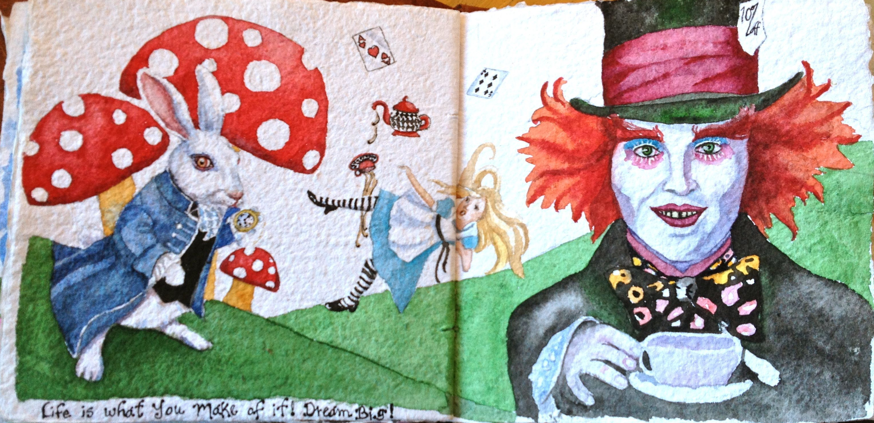
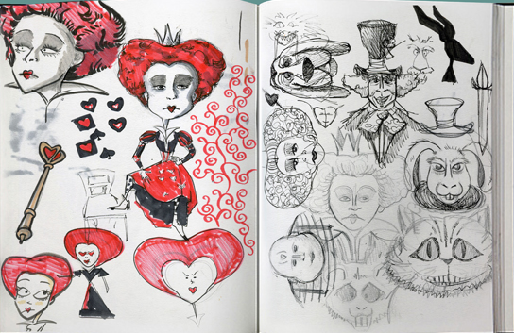
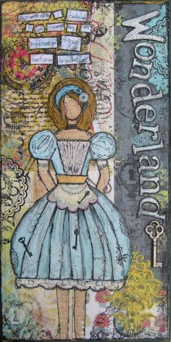
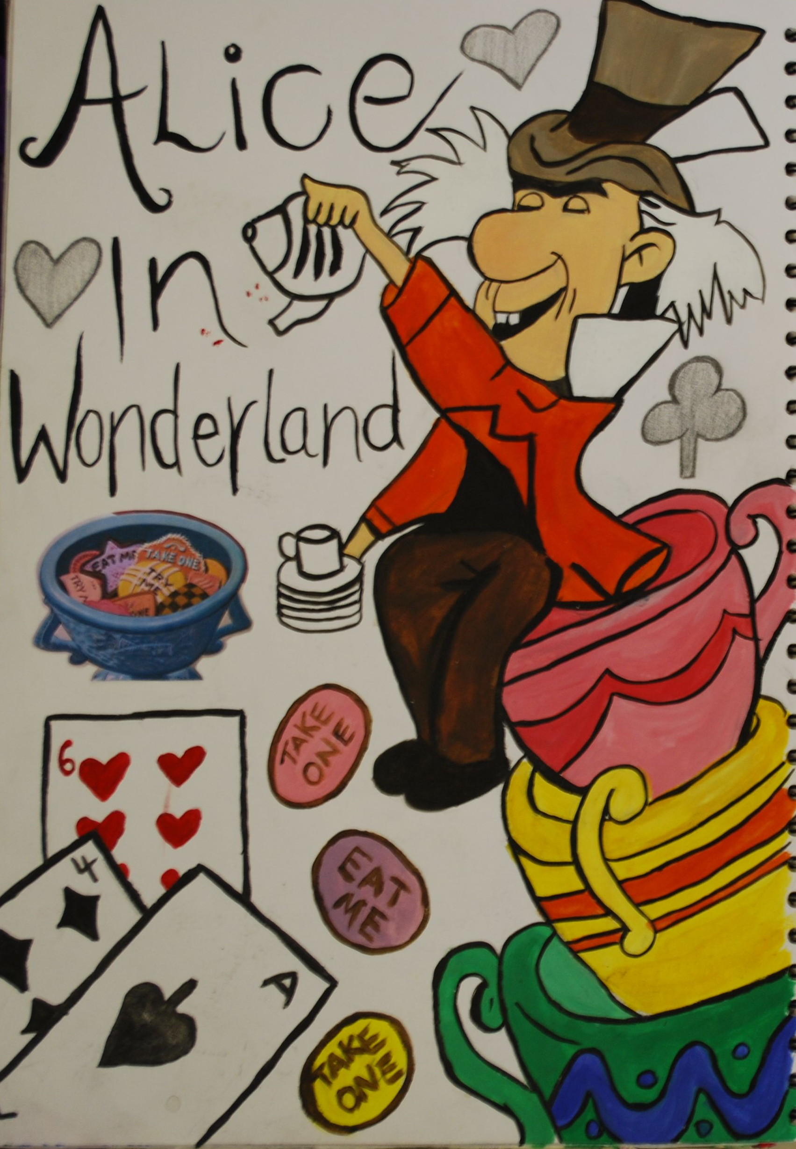
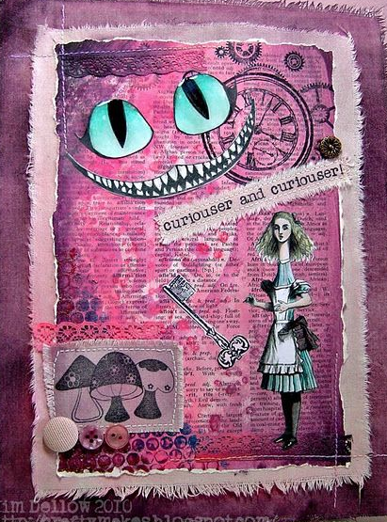
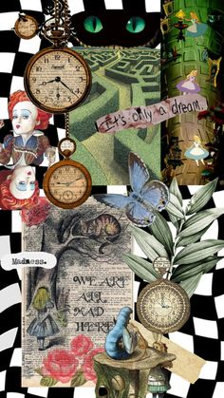
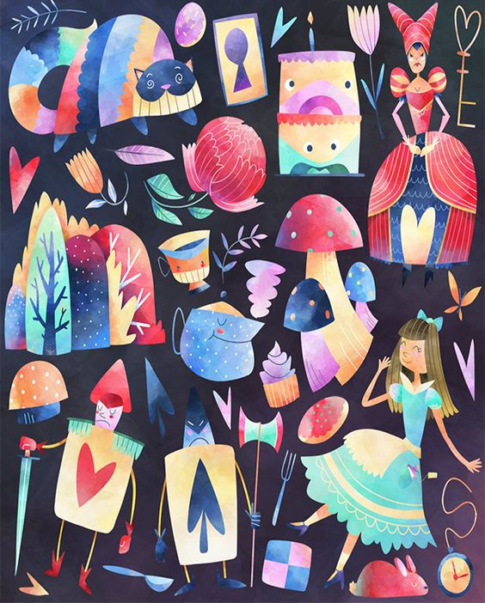
Graphics Transition Work:
Your UNIT 1 title is:
WONDERLAND
TASKS TO COMPLETE:
Watch one or more of the Alice in Wonderland films (Disney’s or Tim Burton’s) and record things that interest you from the film
You could make notes of parts of the film that have imagery you like, (e.g. roses, playing cards, tea party) and draw a few of these things in any media. You could also note down quotes or parts that are key in the film.
Create a title page for the project.
Either do this on A3 paper ready to stick into your sketchbook, or if you already have one, complete it on the first page.
The information you need on your title page is ‘Wonderland’ ‘Unit 1’ and ‘Your Name’
Use this as a way to express your creativity, there are no restrictions on how the title page should look and you can do drawings, collage, a digital based design, whatever you like! But I would like it to reflect what you like doing in your work. It shouldn’t just be an image off the internet!
EQUIPMENT LIST
In order to study Graphic Communication you will need:
A3 Sketchbook, Sketching Pencils, Colouring pencils, Fineliner pens, Good quality felt tips.
Please have these for your first lesson in September.

