Slide 1
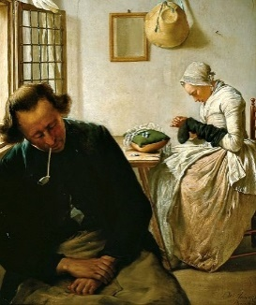
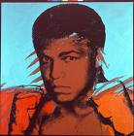
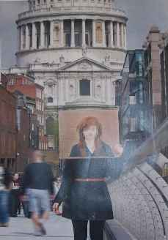
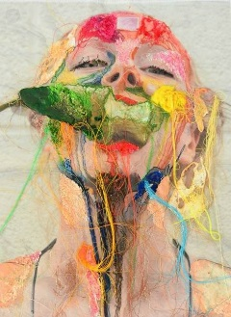
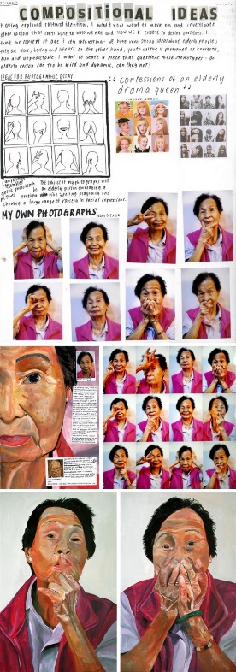
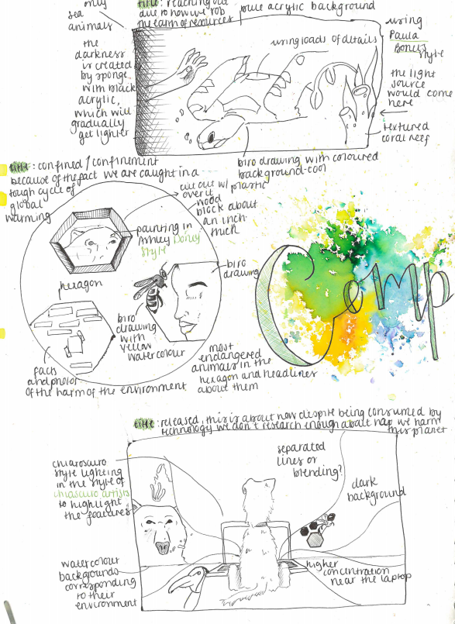
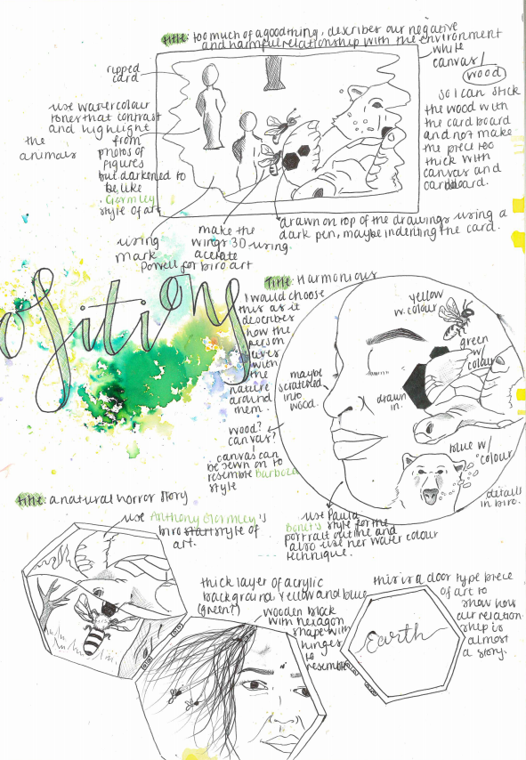
Pick one of the following subthemes to explore. At this point your are NOT limited to a portrait.
Creative Investigation
Autobiography | Symbolism | Relationships
TASKS
Select an artist linking to 1 of the themes
Analyse ONE of their images (use the help sheet overleaf) and produce an artist copy
Take 20+ photos to help explore your theme.
Develop AT LEAST 1 double page of ideas – you need 3 composition ideas linking to your chosen artist and theme.
Produce an A5 outcome in materials of your choice – make sure this has impact even though it’s small!
Present your outcome – this could be framed or presented any way you choose.
Artist Examples
Student Examples

Slide 2
EQUIPMENT PACK
In order to study Fine Art, you will need an equipment pack of specialist kit:
A sketchbook A3 - A2 Portfolio folder – sketching pencils, coloured pencils, fine-liner pen, pastels - oil or chalk, putty rubber, Paints- Watercolours and Acrylics, Set of brushes – sable brushes and large wall paper brushes.
Painting analysis
Subject
In “realistic” painting traditional subjects are portraits and figures landscapes and still life. In “abstract”
works the subject may be more difficult to see, it might even be the “idea” or “feeling” that the artist had.
What is the work about?
What is the subject matter?
Was it observed first-hand, remembered or imagined?
Is it realistic, or distorted to make it more abstract? Can you say why?
Could there be any hidden meanings?
Can you “read” the artwork to discover if it is more than it seems at first glance?
What is the message?
Elements
If you break down a work of art you have the visual and tactile elements; line, colour, tone, pattern, texture, etc
How is it arranged? (Background, middle ground, foreground).
What kind of colour scheme did the artist use? (Harmonious, contrasting, dull, bright etc).
Does it have one main shape or form?
Is it made up of different shapes joined together?
Are there repeated lines, forms, or rhythms?
Has texture been shown or used?
Is the work the same all over or does it have particular features that stand out?
Media
In art terms “media” means materials used by the artist to create their work.
How was the work made, what was it made with?
What materials, tools and techniques did the artist use?
How has the media been applied?
How did the artist start? Where do you think the artist finished?
Has the artist used designs, sketches, photographs or other studies to help with the work?
What skills must the artist have to create the work?
Do you think it took a long time or was it done quickly?
Intent
What drove the artist to create the work in the first place? Unless you research into the artist you might find this question difficult.
What is the purpose of this work?
Does it achieve its purpose?
Does the context of the work give you any clues to the artist’s intention?
What do you think the artist was thinking when working on it?
Does the work affect you in any way?
Do you like or dislike it? Give 3 reasons why / why not.

